Slide 1
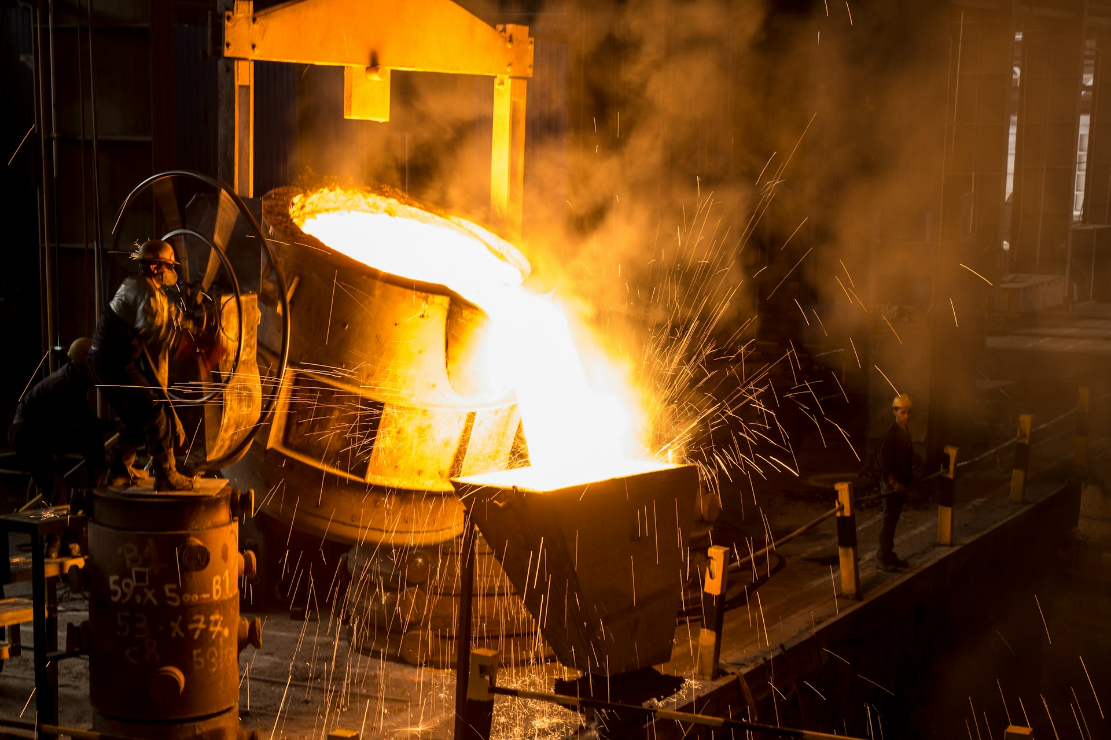
Reaching for the Steel
Gyanesh Samanta
Xavier Institute of Management, Bhubaneswar

Slide 2

EXECUTIVE SUMMARY
Towards the Future

Slide 3




Executive Summary
KSL should invest in IoT and Ai Technologies to revamp their current processes and achieve scale in the near future.
The Challenge
Solution Implementation
Fluctuating Raw Material Prices lead to varying Operating Expenses
Raw Material Inventory and Order Cycle are operated without data driven decision making
Energy Expense Increases and lack of availability of sustainable energy throughout
Lack of sustained, sufficient energy can half operations
Competitive market in a commodity product, creates a Red Ocean environment
Reactive maintenance Strategies lead to delay in process optimization
Implement IBM Sterling OMS + Manhattan WMS for Resource Planning and Order Optimization
OMS + WMS sets the path for a steel manufacturer as KSL to keep a check on their inventory, raw material and optimization in delivery pipelines.
Sustainability Initiatives: In Manufacturing Industry CSR and sustainability initiatives lead to direct tax benefits, which is essential as it helps with Financials for KSL
IoT and AI will help KSL have an End-to-End Visibility on their process, enable data driven decision making and scale the company to newer heights
KSL should NOT CONTINUE current practice
KSL should INVEST in IoT and AI

Slide 4
Industry Research
Market Overview

Slide 5
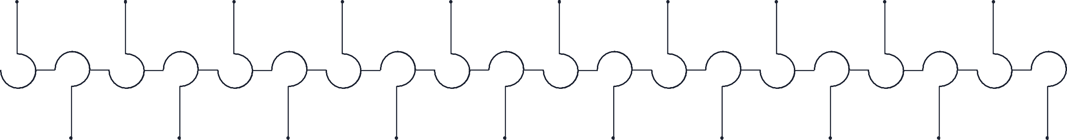










Overview and Potential of Artificial Intelligence
Due to significant interest and diverse applications, AI is poised to revolutionize industries, potentially growing to a nearly $2 trillion market by 2026
With increasing investments…
… and huge automation potential…
25% 10-20%
…the AI market is bound to grow substantially
Private AI investments in $ bn
Global AI Revenue forecast ($ m) with Gen AI's share
160
140
120
100
80
60
40
20
0
World US China
1,847,496
1,415,055
CAGR 36.6%
1,068,718
Of advanced economies, labor tasks projected to be automated by AI
Of emerging economies, labor tasks projected to be automated by AI
795,385
582,949
298,247
207,902
18.6% 21.8%
420,466
28.0%
95,603
142,320
26.8%
27.6%
4.9%
23.9%
25.8%
17.2%
24.7%
2019 2020 2021 2022 2023E 2024E 2025E 2021 2022 2023 2024E 2025E 2026E 2027E
The AI market has continuously evolved over the past two decades, introducing numerous groundbreaking applications
2028E 2029E 2030E
2009 | 2011 |  | 2012 | 2014 | 2016 | 2017 | 2018 |  | 2020 | 2021 | 2022
Google begins |  | IBM’S Watson | Large neural network | Chatbot “Eugene” | Introduction of | Training chatbots for |  | Google Duplex, Ai | Introduction of Open | Introduction of |  | Introduction of
developing driverless |  | computer wins | training to recognize | convinced judges to | Sophia, a robot that | human-like |  | assistant that books | AI’s Chat GPT 3 | LaMDA, a large |  | Stable “Diffusion”,
cars |  | Jeopardy game | cat images | be a human | can "see" and | interaction and mutual |  | appointments via | language model | language model for |  | a text-to-image
 |  | show |  |  | express facially | communication |  | phone |  | human-like responses |  | AI
Launch of first gaming device tracking human
movement
2010
Introduction of Siri, a voice assistant
Introduction of a
virtual assistant
Introduction of
the virtual assistant Alexa
AlphaGo, a computer program, beats Go world
champion
2016
Alibaba AI outperforms humans in Stanford
test
2018
Introduction of T-NLG, largest language model
at the time
2020
Unveiling of OpenAI’s DALL-E,
an image-creation
AI
2021
Public debut of
ChatGPT
Unveiling of Bard, Alphabet’s generative AI tool
2011 2012 2014
2022
2023
Source: (Thormundsson, B., 2023), (Statista, (2024a, 2024b, 2024c)), (Nathan, A., Grimberg, J., Rhodes, A., 2023), (Solberg, T.L., 2023), (Goldman Sachs, 2023)

Slide 6







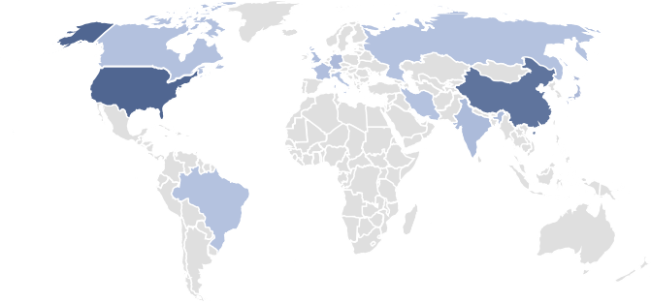
Overview and Potential to the Internet of Things
Increased connectivity amongst devices will accelerate Cloud demand
Internet of Things connects interacting devices in one network
Four key trends indicate a 94.4% surge in IoT-connected devices by 2030
Definition
IoT connects physical objects with embedded sensors, software, and connectivity to collect and exchange data, ranging from household items to industrial tools
Applications
Connectivity
IoT market trends and total number of IoT connected devices in million by 2030
These devices communicate with each other and the internet, facilitating autonomous data exchange and actions across
various environments like homes and cities
AI integration in IoT leads to smarter, data-driven decisions and enhanced predictive analytics, boosting operational efficiency
CAGR 9.96%
Enhanced connectivity in IoT facilitates seamless data exchange and inter-device communication, optimizing network performance
29,422
Challenges
Increased automation in IoT streamlines processes and reduces manual intervention, elevating productivity and consistency
15,138
IoT enhances global efficiency and operations with advanced solutions like energy management and supply chain optimization, promoting better resource use and streamlined processes
Successful IoT implementation involves tackling issues like data security, device interoperability, and complex data management, necessitating strategic planning and robust security
Edge computing in IoT brings data processing closer to the source, reducing latency and enhancing real-time decision-making
2023 2030E
US leads the market, with growth of revenues outpacing devices
IoT device cyber attacks rise, averaging $4.45m costs per breach
IoT revenue by region and projections through 2030 ($ bn)
Percent of companies with weekly attacks in first two months of the year
+112.0%
70
Europe
APAC
621,6
60
50
Latin America North America Africa
$ 4.45 m
40
293,2
30
20
10
Average cost of
a data breach¹
#1 USA #2 China #3 Japan #4 Germany #5 India
Note: ¹ Not including reputational or future income damage
2023 2030E
0
2021
2022
2023
Source: (IBM, n.d.a), (ComputerWeekly.de, 2024), (Antino, 2024), (Statista, 2023f), (Check Point research, 2023), (Petrosyan, A, 2024)

Slide 7

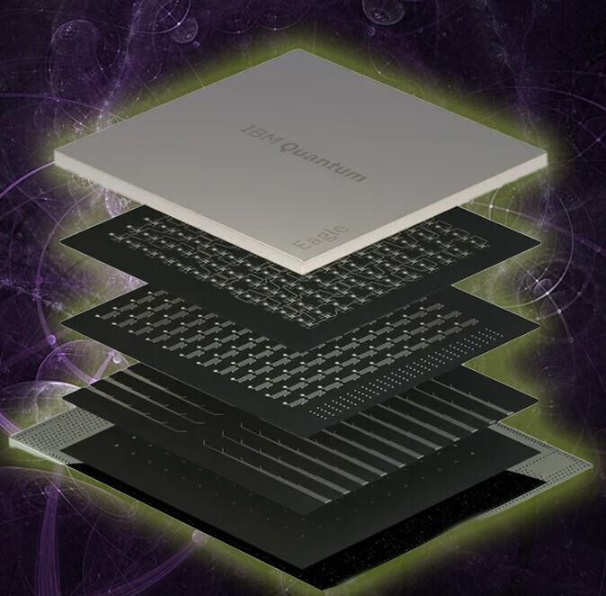
STRATEGIC FIT
KSL
AI
IoT
The Company
The Controller
The Fuel

Slide 8



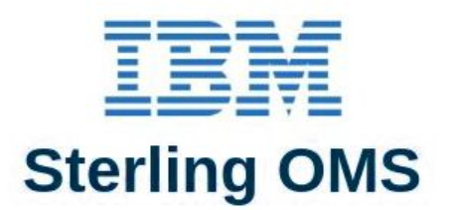
AI Implementation Strategy
Focus on core offering: Steel Manufacturing while relying on industry leaders for AI Implementation for Business
Artificial Intelligence (AI) Internet-of-Things (IoT)
10% - 25%
of labor projected to
be automated by AI
36.6%
2030 CAGR
Peak AI hype
9.96%
2030 CAGR
$ 4.4m
Average cost of a data breach
AI will revolutionise industries but is at the peak of the hype cycle
The internet of things is growing fast and loose, lacking cybersecurity
Digital First Principle while relying on Industry Experts for Decade+ AI Experience
IBM OMS
Sterling OMS offers Sterling Inventory Visibility and Sterling Intelligent Promising which are key to addressing our raw materials issue
Manhattan WMS
Manhattan Active WMS allows KSL to keep a check on the supply side raw materials, organize Warehouses for maximum efficiency
&
Source: Grimond, L., Beyer, M. and Maguire, A., 2023), (Kolesnikov, N., 2023), (Statista, 2024b)

Slide 9



AI Implementation Strategy
Focus on core offering: Steel Manufacturing while relying on industry leaders for AI Implementation for Business
Current Problems Identified can be solved by…
…Cohesiveness in Technology implementation
No AI or IoT for Automation and Predictive Maintenance
Large parts of repetitive, pattern-based intellectual work is automated as AI finds industrial usage, largely boosting productivity and changing tertiary work.
Problems highlighted
Raw Material Management Technologies
Energy Efficiency Solutions
Production Optimization Techniques
Predictive maintenance Infrastructure
Quality control Enhancement
Ecommerce
Interconnected Operational Challenges
The flow of data between objects and people increases exponentially as industrial
and human systems become increasingly interconnected and online.
IBM Watson Supply Chain Intelligence + Sterling OMS Integration + IBM Watson IoT for Manufacturing
Reactive Maintenance Paradigm
Reactive maintenance results in unexpected downtime which can cost upto 200 Cr INR in the steel manufacturing industry. .
Solution headers
Manhattan Active Allocation + Manhattan Active WMS + Manhattan Active Quality management
Siemens Style Digital Twins + JFE Steel J-mAIster® Approach
IBM Maximo Visual Inspection + Digital Twin model
...
Raw Material management
Energy Efficiency Solutions
Production optimization
Predictive Maintenance
Quality Control Improvement
Technology Stack
IBM Watson Supply chain Intelligence
Mahanttan Active Allocation
Sterling OMS Integration
IoT Sensor Networks
IBM Watson IoT
Digital Twin Energy Models
Manhattan Active WMS
IBM Maximo Visual Inspection
Siemens-style Digital Twin
IBM Watson IoT Predictive Analytics
JFE Steel J-mAIster Approach
IoT Integration
IBM Maximo Visual Inspection
Manhattan Active Quality Management
Computer Vision + Acoustic Analysis

Slide 10
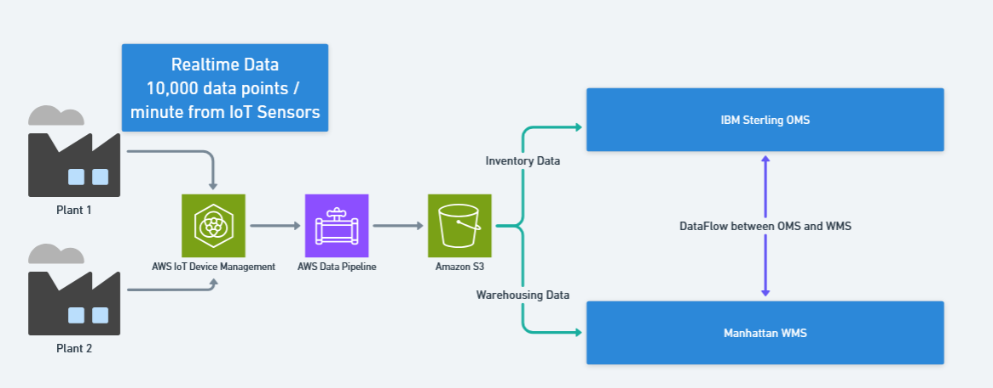



Phase Implementation Approach: Change Management Framework
Following PWC’s proven Framework: Interest -> Awareness -> Trial -> Adoption Methodology
Phase 1: Foundation & Awareness
Phase 2: Trial & Scale
Phase 3: Adoption and Optimization
Expectations for emerging technologies..
..Scaled Deployment across Production Lines..
..Autonomous Operations, Continuous Improvement
1
Infrastructure Setup, Pilot, Team building with Organization wide AI literacy programs and Stakeholder engagement
1
Investment: INR 60 Cr
Scaled Deployment across major production Lines
1
Investment: Ongoing Operational Costs (32 Cr/Yr)
Full Integration, Autonomous Operations, Continuous Improvement and deployment
2
IBM Watson Pilot on 2-3 Production lines, initial IoT sensor deployment
2
Technology: Manhattan WMS Integration, Sterling OMS Deployment, Expanded Digital Twin
2
Complete Ecosystem integration, Gen AI Applications exploration
3
Benefits: 40% of full savings realization (INR 413 Cr)
3
Benefits: 80% of full savings realization (INR 826 Cr)
3
Benefits: 100% savings realization (1033 Cr)
Critical Data Architecture for…
…Big Data Applications
Big Data Analytics Applications:
Pattern Recognition: Analysis of historical data to identify optimization opportunities and predict future performance
Predictive Modeling: Complex algorithms processing multiple variables to forecast equipment failures, demand patterns, and quality issues
Real-time Decision Making: Stream processing of live data enabling autonomous adjustments to production parameters

Slide 11
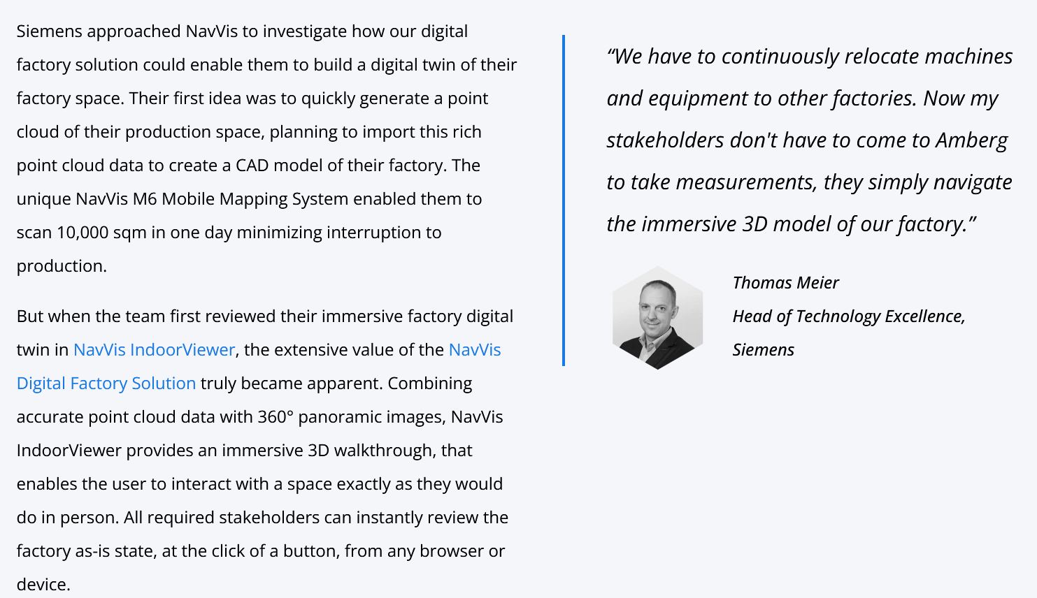

Case Study: Siemen’s Exploration into Digital Twins
Siemen’s Solution
Assembly Line Planning & Relocation
Relocates ~4 assembly lines (60–70m) annually between factories
Earlier: multiple on-site visits required (EWA → Amberg)
Now: planners share digital twin links → remote teams measure & plan virtually
Virtual Factory Tours
Siemens conducts 400+ tours annually at EWA
Digital twin enhances balcony view with zoom-in on machines/lines
Presented via touch-enabled terminals for interactive experienc
IoT Integration
Connected live production performance & quality data with POIs in digital twin
POIs highlight machines/lines & collate contextual data
Digital twin serves as a visual interface for IoT data streams

Slide 12
Risks and Challenges
Upfront!

Slide 13
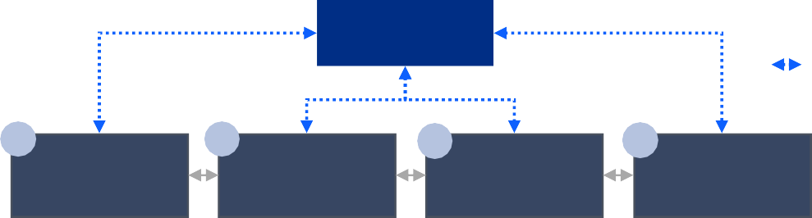
The Future Economy is Digital - and so are its Vulnerabilities
Risks and mitigation of a Digital Implementation of IoT and AI
As digitization continues to transform the economy…
… a few key verticals face hesitancy to deploy innovative, digital technologies out of significant security and safety concerns and high system complexity
Digitization Levels across industries
Operational
Capital
Cloud
Time-to-market, cost or threat management?
Firms face fundamental tensions between business productivity needs and cybersecurity risks.
Currently, only a few industries have fully digitized their operations, their assets, and deployed Cloud technologies to capitalized on the power of data in their business.
As data flows become more significant, this tradeoff becomes more acute.
_{Industry Data Sensitivity} Digitization Digitization Deploymen
Media & Telecommunications
Retail & (e-)Commerce
Finance & Insurance
Personal, Local Services
Personal Mobility
Industrial Manufacturing
Shipping and Transportation
Entertainment & Recreation
Government Administration
Military
Healthcare & Hospitals
t
Every aspect of the ‘digital’ enterprises requires robust cybersecurity models
Digital Leaders
An organization is as vulnerable to cyberthreats as its weakest link: cybersecurity models must be
robust and encompass all nodes in its data network.
Risk Management cultures require company-wide technology deployments.
Digitization Across the Supply Chain: risks & solutions
Advanced Cloud Connectivity
Goods & Services Flows
Data Flows
1
2
Goods / Services Production
3
4
Supply
Employees
Customers
Risks:
Vendor pricing
exposure, material and process leakage, supply interruption
Risks:
Shutdown / disruption,
Trade secret / process leakage, Attacks on production quality
Risks:
Shutdown / Disruption, Process leakage,
Risks:
Client data & security exposure, service disruption
Overall: Cyberthreats have significant monetary, reputational, legal and productive consequences
Digital
Laggards
Necessary Cross-Chain Solutions
Risk & Vulnerability Detection Systems | DevSecOps | IR Planning & Testing
EDR Tools | Managed Service Partners | Risk & Vulnerability Detection Systems
Low
High
Source: (Gartner, 2023), (Statista, n.d.a) (Statista, n.d.b)

Slide 14
Challenges and Mitigation
A look into the challenges and mitigations
Challenge
Mitigation
Automation may reduce manual labor requirements, creating employee anxiety and resistance
Comprehensive retraining programs converting operations staff into AI system operators, with analytics academies providing data science education
Increased connectivity creates vulnerabilities to cyber attacks and data breaches
Multi-layered security architecture including network segmentation, multi-factor authentication, intrusion detection systems, and regular security audits
Legacy system integration with modern AI platforms requires significant technical expertise
Phased implementation approach with specialized integration partners and gradual system replacement strategies
Cultural resistance to data-driven decision making and automated processes
Clear communication of benefits, stakeholder involvement in implementation planning, and demonstration of early wins through pilot programs

Slide 15
Financials

Slide 16
Challenges and Mitigation
A look into the challenges and mitigations
Cash Flow Projection (Base Case, 100% Savings Realization)
Investment Buckets
Year | Capex (INR Cr) | Operating Cost (INR Cr) | Savings Realized (INR Cr) | Net Cash Flow (INR Cr) | Cumulative Cash Flow (INR Cr)
0 | 180 | – | – | -180 | -180
1 | – | 32 | 413 | 261 | 81
2 | – | 32 | 826 | 734 | 815
3 | – | 32 | 1,033 | 1,001 | 1,816
Digital Infrastructure (INR ~80 Cr)
Smart grid systems, IoT sensors, predictive analytics platforms
Process Automation & AI (INR ~60 Cr)
Automated inspection, process optimization algorithms
Energy & Production Efficiency (INR ~40 Cr)
Furnace upgrades, throughput optimization
Workforce Transformation (INR ~20 Cr)
Training, change management, digital adoption
Risk Scenario Analysis
Scenario | Annual Savings (INR Cr) | Year 1 Net CF | Year 2 Net CF | Year 3 Net CF | 3-Year ROI | IRR
Conservative (70%) | 723 | 146 | 549 | 702 | 1041% | >150%
Base Case (100%) | 1,033 | 261 | 734 | 1,001 | 623% | 224%
Optimistic (130%) | 1,342 | 376 | 919 | 1,300 | 2089% | >300%
➡ Total Initial Investment: INR 180 Cr ➡ Annual Operating Costs: INR 32 Cr
This initiative requires INR 276 Cr (over 3 years) but delivers INR 1,996 Cr in net value, with an IRR of 224% and payback in <1 year. It lifts EBITDA from 25% to 35%, improving profitability by 40%. Even under conservative assumptions, returns remain measurable.

Slide 17
Cost Benefit Analysis
A deeper look at the Returns on our Investments and ICE Prioritization
Priority | Area | Savings (INR Cr) | % Improvement / Reduction | Key Drivers | Impact | Cost | Effort
1 | Energy Efficiency | 300 | 20% consumption reduction | Furnace optimization, smart grid management | High | Medium | Medium
2 | Production Optimization | 200 | 8% throughput improvement | Bottleneck elimination, process optimization | High | Medium | High
3 | Predictive Maintenance | 200 | 25% cost reduction | Proactive scheduling, downtime prevention | High | Medium | Medium
4 | Raw Material Management | 158 | 3.5% cost reduction | Optimized procurement, better inventory, waste cut | Medium | Low | Medium
5 | Quality Control | 175 | 35% cost reduction | Automated inspection, defect prevention | Medium | High | High
– | Total Gross Savings | 1,033 | – |  | – | – | –
– | Net Additional EBITDA | 1,001 | – | After accounting for operational costs | – | – | –
Energy Efficiency is the Top Lever
With INR 300 Cr annual savings, this delivers the highest financial impact.
Moderate cost and effort make it a quick-win strategic initiative.
Improvements in energy also cascade into sustainability metrics (lower emissions, ESG reporting).
Raw Material Management is a Steady Value Driver
Savings are smaller (INR 158 Cr, 3.5% cost reduction), but with low cost and moderate effort it’s a low-hanging fruit.
Quality Control Has High Savings Potential but High Effort/Cost
Despite INR 175 Cr potential, the automation and inspection setup requires heavy investment and execution effort.
Should be considered in later phases once quick wins are captured.

Slide 18
Strategic Takeaways

Slide 19
Strategic Recommendations – Key Takeaways
Short Term
Medium Term
Long Term
Establish AI Steering Committee with C-level sponsorship and cross-functional representation
Conduct Detailed Technical Assessment of existing infrastructure and data readiness
Initiate Pilot Program focusing on predictive maintenance for 2-3 critical assets
Secure Initial Investment of INR 60 Cr for Phase 1 implementation
Scale Successful Pilots across all major production lines
Implement Comprehensive IoT Infrastructure with cloud-based analytics platform
Deploy Energy Optimization Systems targeting 15-20% consumption reduction
Launch Workforce Retraining Programs for affected personnel
Establish Cybersecurity Framework with industry-leading security protocols
Achieve Full AI Integration across all operational domains
Develop Digital Twin Capabilities for autonomous plant operations
Explore New Business Models leveraging AI expertise and data assets
Position as Industry Innovation Leader in smart manufacturing

Slide 20
Assumptions
Category | Key Assumptions
Financial | - Raw material costs = 45% of revenue (industry standard) - Energy costs = 15% of revenue (steel sector avg) - Phased implementation over 18 months with gradual savings realization - Conservative savings estimates based on industry benchmarks - No carbon credit or regulatory savings included
Technology | - Cloud infrastructure available & scalable - IoT sensor reliability in harsh steel environments - AI model accuracy dependent on sufficient historical data - Integration feasibility with legacy systems - Cybersecurity effectiveness against evolving threats
Operational | - Management commitment to data-driven decision making - Workforce adaptability to new technologies/processes - Supplier cooperation in data sharing & integration - Stable regulatory environment for industrial AI - Market continuity during transition

Slide 21
Sources
https://www.steel-technology.com/articles/the-role-of-artificial-intelligence-in-steel-production
https://aimlprogramming.com/services/ai-enabled-predictive-maintenance-for-steel-plants/
https://www.wizata.com/industries/metal-mining
https://www.wizata.com/knowledge-base/resources/how-can-steel-production-reduce-costs-by-using-ai-in-manufacturing
https://www.steel-technology.com/articles/the-role-of-ai-in-predictive-maintenance-for-steel-plants
https://c3.ai/customers/steel-company-transforms-value-chain-with-ai/
https://sugnatmt.com/how-ai-and-automation-are-transforming-the-tmt-steel-industry/
https://www.iiot-world.com/predictive-analytics/predictive-maintenance/predictive-maintenance-hidden-roi-driver/
https://www.ulmaforge.com/en/new/artificial-intelligence-in-steelmaking/
https://www.ripik.ai/ai-for-sustainable-and-greener-steel-manufacturing/
https://www.assetwatch.com/blog/steel-and-metal-ai-predictive-maintenance
https://gmbindustries.com/steel-mill-automation-how-ai-and-robotics-are-transforming-the-industry/
https://www.metalbook.com/blogs/can-ai-really-predict-machine-breakdowns-in-steel-plants/
https://www.sensegrow.com/blog/customer-stories/ai-driven-cost-effective-maintenance-strategy-for-steel-industry
https://nanoprecise.io/predictive-maintenance-in-steel-plant/
https://www.data-spree.com/blog/how-to-calculate-roi-for-ai-in-production
https://eoxs.com/new_blog/how-to-implement-digital-transformation-in-steel-manufacturing-strategies-and-advantages/
https://dbmsteel.com/optimizing-energy-consumption-ai-strategies-for-sustainable-steel-production/
https://www.multimodal.dev/post/how-to-calculate-ai-roi
https://www.steel-technology.com/articles/digital-transformation-in-steel-industry-leveraging-data-for-competitive-advantage
https://www.bcg.com/publications/2021/value-of-ai-in-steel-industry
https://www.infosys.com/industries/mining/documents/leveraging-digital-technologies.pdf
https://www.pwc.com/us/en/tech-effect/ai-analytics/artificial-intelligence-roi.html
https://factoryeye.magicsoftware.com/metal-processing/
https://www.epicflow.com/blog/how-to-calculate-roi-for-a-project/
https://eoxs.com/new_blog/10-proven-cost-reduction-strategies-for-steel-manufacturing/
https://greenovative.com/industries/steel-industries/
https://www.supplychainbrain.com/blogs/1-think-tank/post/40959-overcoming-barriers-to-ai-adoption-in-manufacturing-a-roadmap-for-transformation
https://eoxs.com/new_blog/ai-in-steel-quality-control-improving-accuracy-and-efficiency/
https://eoxs.com/new_blog/protecting-steel-industry-assets-top-cybersecurity-practices-you-need-to-know/
https://www.vellum.ai/blog/how-successful-companies-implement-ai-reliably
https://buyabeam.com/blogs/uncategorised/ai-steel/
https://appinventiv.com/blog/ai-in-manufacturing/
https://weboccult.com/blog/how-computer-vision-ai-is-impacting-the-steel-manufacturing-industry-in-2025/
https://eoxs.com/new_blog/overcoming-challenges-in-digital-transformation-for-steel-manufacturers/
https://www.pwc.com/gx/en/industrial-manufacturing/pdf/intro-implementing-ai-manufacturing.pdf
https://robovision.ai/ucp-ai-vision-surface-inspection-steel
https://tupl.com/solutions/ai-computer-vision/ai-computer-vision-quality-inspection/
https://integrio.net/blog/cloud-computing-in-manufacturing-industry
https://aiexpert.network/case-study-tata-steels-ai-transformation/
https://www.intuz.com/blog/iot-in-steel-manufacturing
https://skillfloor.com/blog/the-impact-of-cloud-computing-on-data-analytics-and-big-data

